Slide 1
The Effect of Moneyball on Major League Baseball

Slide 2
Background
Moneyball by Michael Lewis
nonfiction book about the Oakland Athletics in the early 2000s who exploited inefficiencies in the player market to defy expectations given their low payroll
MLB Draft Rights
OBP vs BA
The goal of this project is to find what, if anything, changed at the team level and the role of money throughout Major League Baseball following Moneyball’s publication in 2003

Slide 3
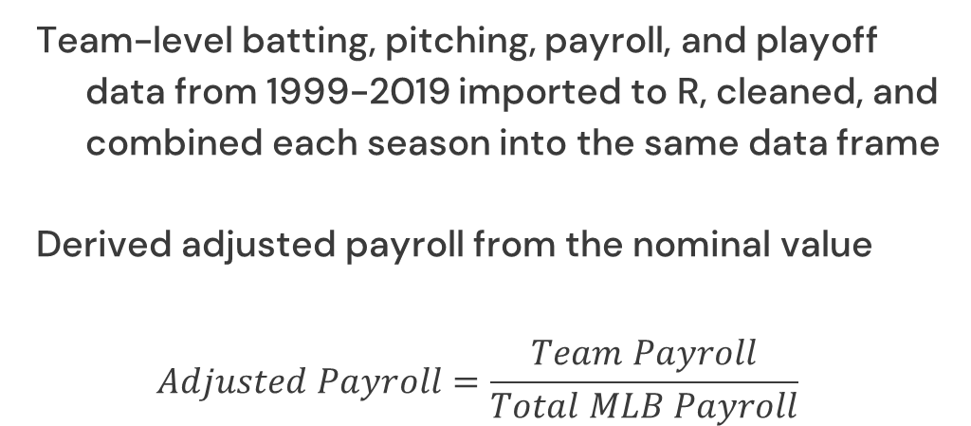
Data
Team-level batting, pitching, payroll, and playoff data from 1999-2019 imported to R, cleaned, and combined each season into the same data frame
Derived adjusted payroll from the nominal value
$$Adjusted Payroll=\frac{Team Payroll}{Total MLB Payroll}$$

Slide 4
Terms
Sabermetrics
The empirical analysis of baseball data
Plate Appearance
Number of times a player completes a turn batting regardless of the result
OBP
Similar to batting average, but includes walks, HPB and SF

Slide 5
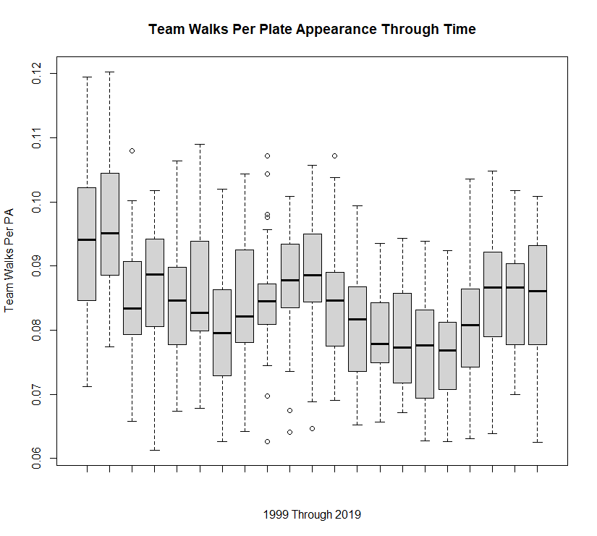
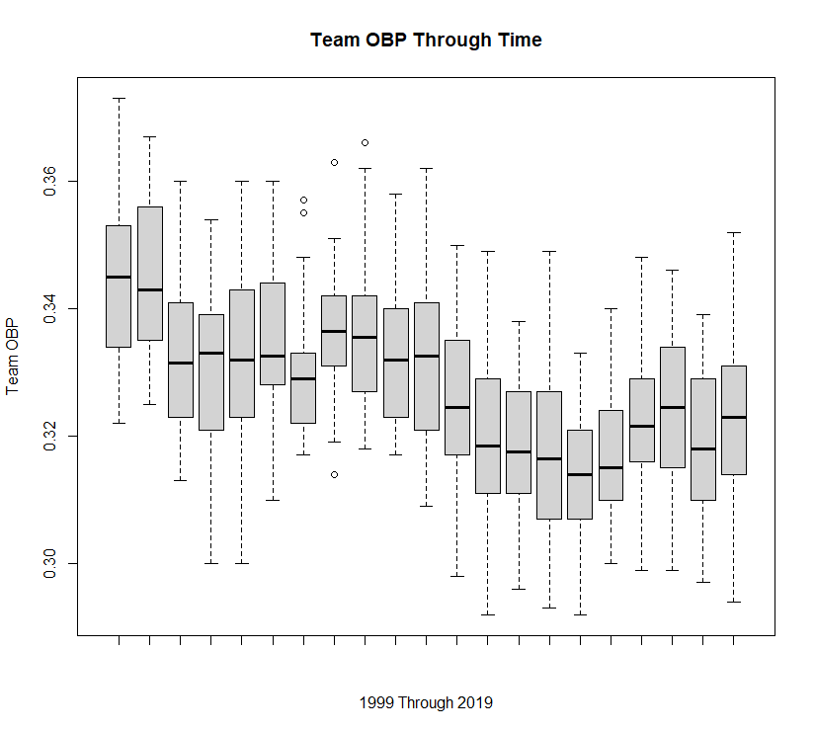
Walks and OBP Box Plots Through Time
I was expecting an upward trend in both charts since Moneyball revealed the importance of walks to a team’s success

Slide 6
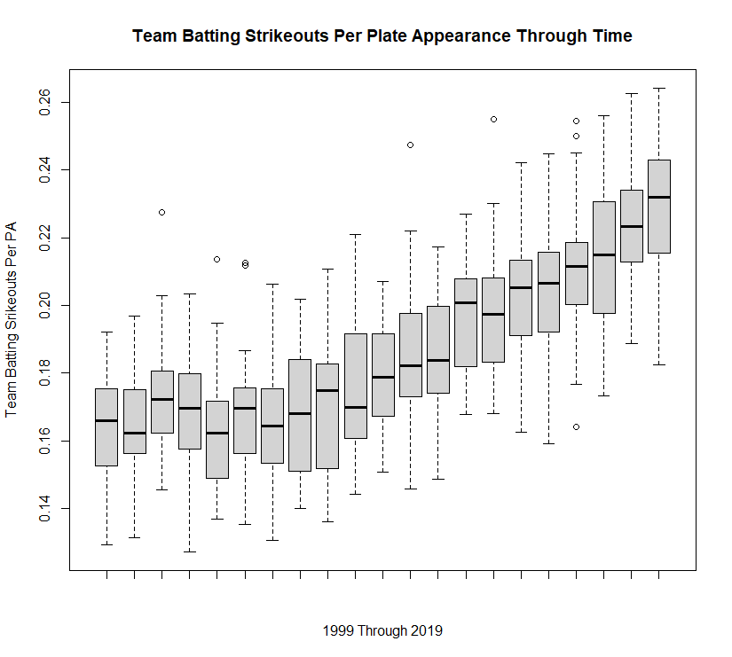
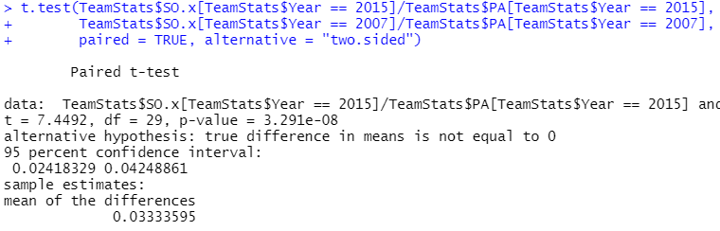
Strikeouts Through Time
The pitching side shows a clear increasing trend in the proportion of strikeouts per plate appearance
Paired t-test shows evidence of a statistically significant increase in strikeout per plate appearance in 2015 compared to 2007

Slide 7
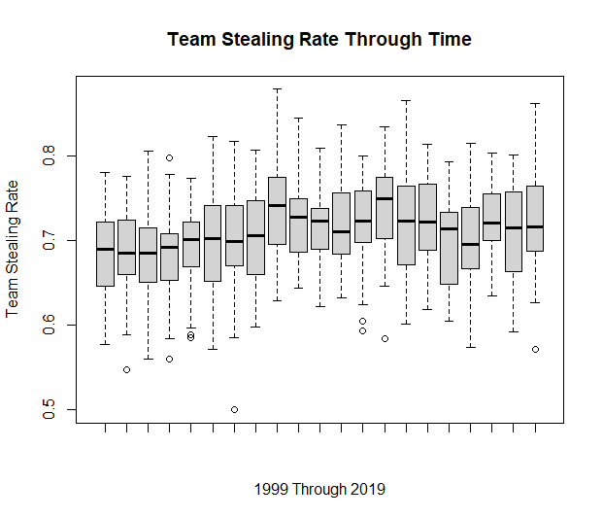
Base Stealing Rate Through Time
It’s also important to preserve the baserunners you have
Teams at the lower tail seem to increase their stealing rate in the mid-2000s
Some early vs recent seasons are statistically significant in paired t-tests

Slide 8
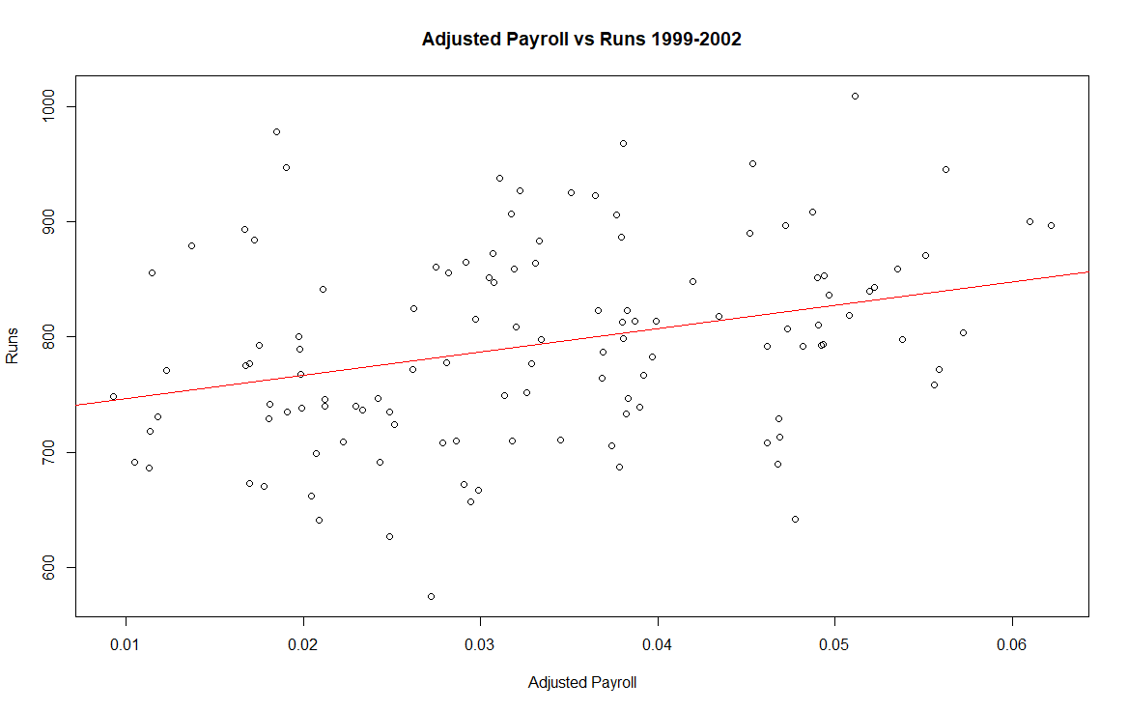
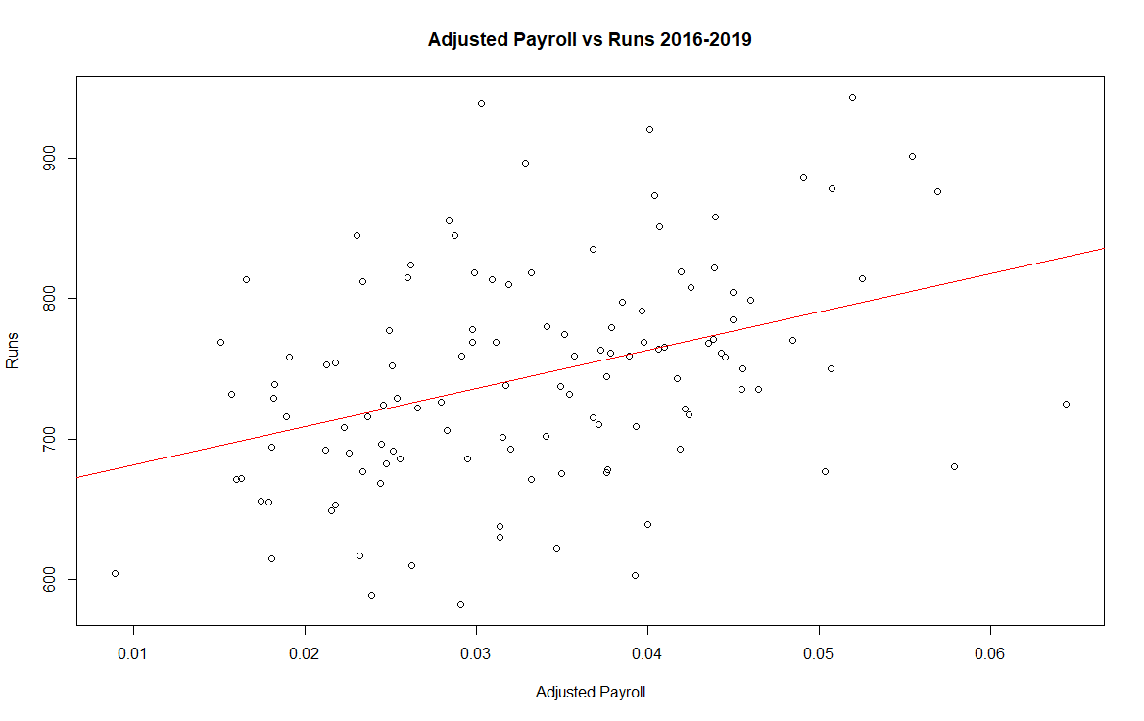
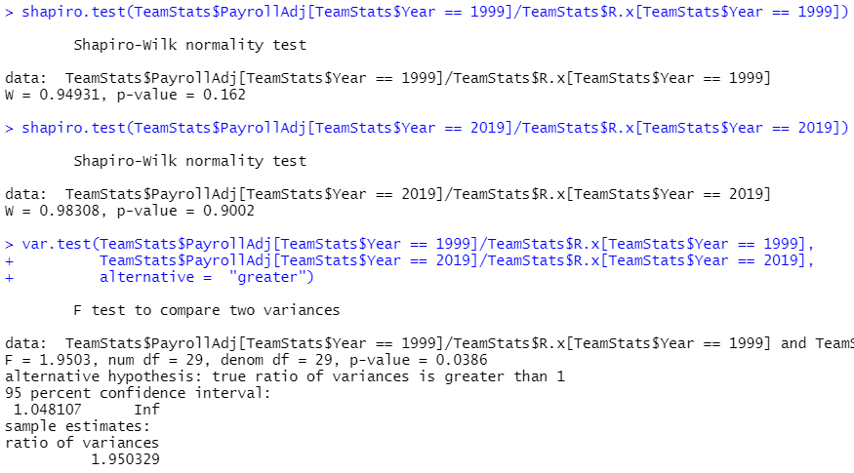
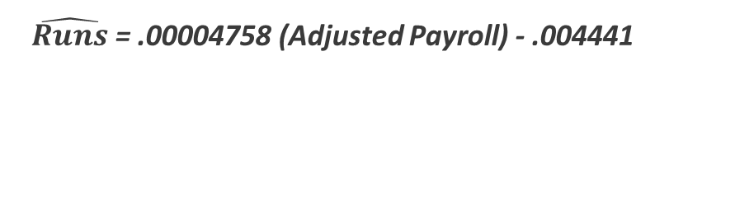
Adjusted Payroll Per Run
Adjusted Payroll vs Runs in both cohorts have weak correlations
The 2016-2019 cohort has a slightly higher correlation (0.3850) than the 1999-2002 cohort (0.3104), but it’s not statistically significant
The variance of adjusted payroll per run significantly decreased comparing 1999 to 2019
$\hat{Runs}$ = .00004758 (Adjusted Payroll) - .004441
$\hat{Runs}$ = .00005445 (Adjusted Payroll) - .007246

Slide 9
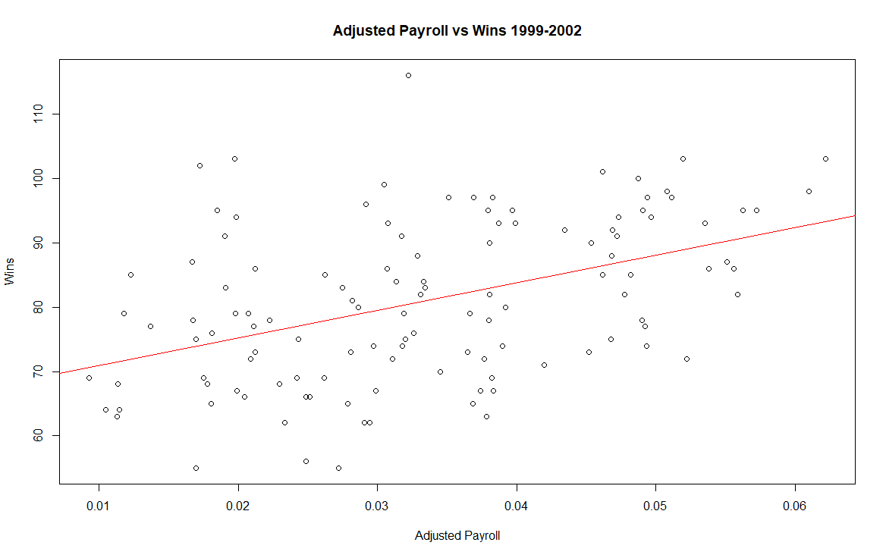
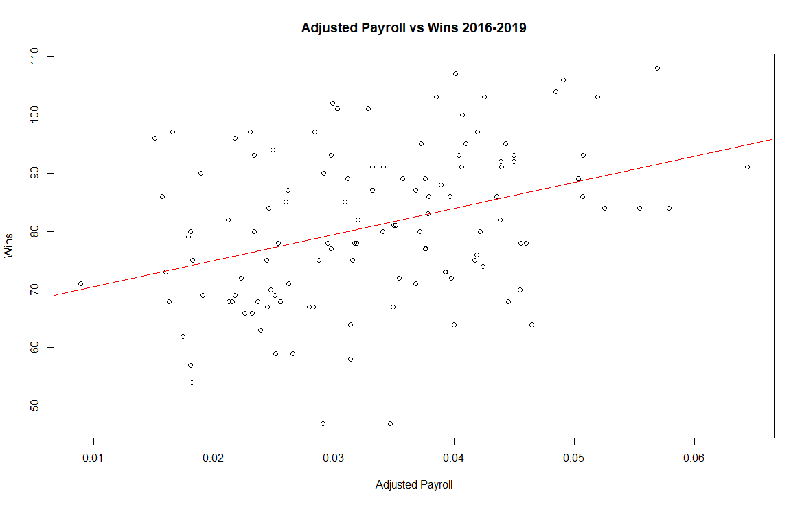
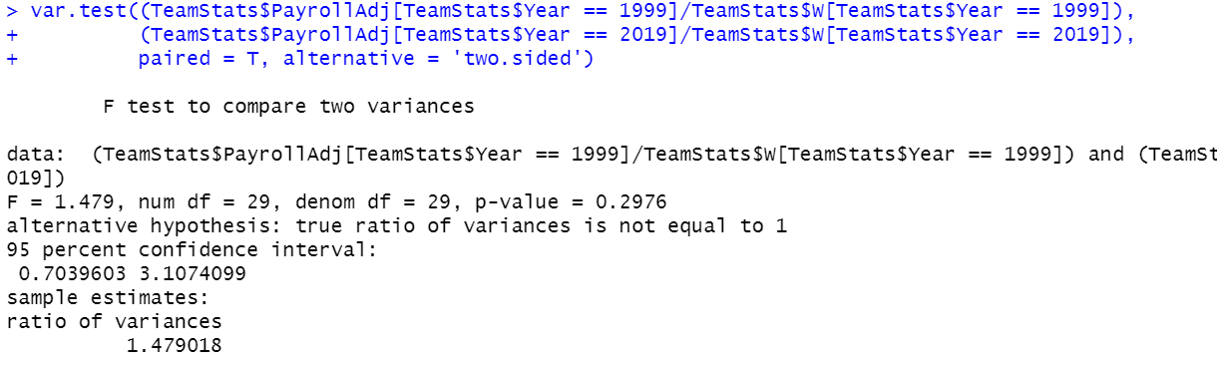
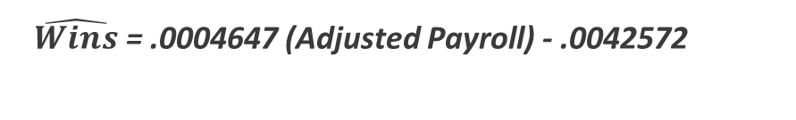

Adjusted Payroll Per Win
Adjusted Payroll vs Wins in the recent cohort has a weak correlation and the early cohort has a moderate correlation
The 2016-2019 cohort has a slightly lower correlation (0.3679) than the 1999-2002 cohort (0.4465), but it’s not statistically significant
The same variance test (1999 compared to 2019) executed on adjusted payroll per run is not significant on adjusted payroll per win
$\hat{Wins}$ = .0004647 (Adjusted Payroll) - .0042572
$\hat{Wins}$ = .0003017 (Adjusted Payroll) - .008906

Slide 10
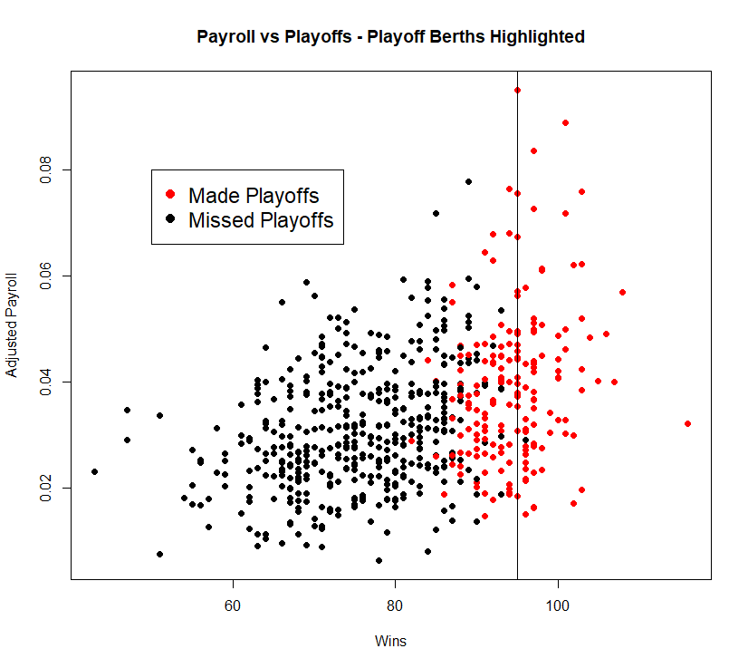
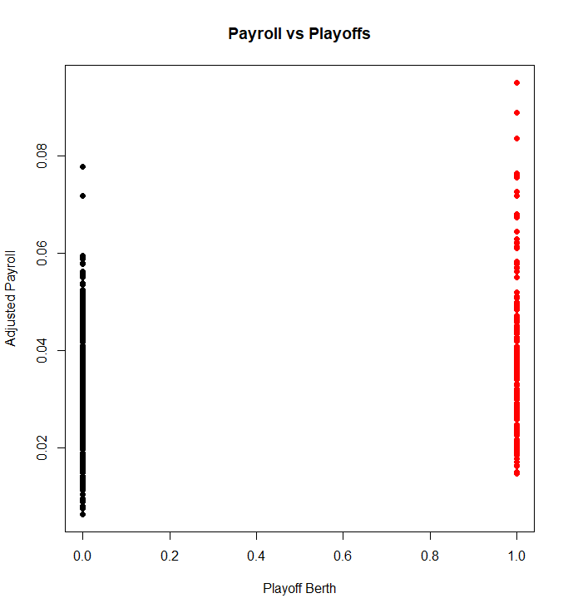
Playoff Berth by Wins and Payroll
The Athletics’ estimated 95 wins to make the playoffs
There is a lot of overlap between adjusted payroll and achieving a playoff berth
Changing the x-axis to binary playoff berths shows a high frequency of very low payroll teams missing the playoffs and very high payroll teams making the playoffs

Slide 11
Conclusion
I was surprised to find a lack of increased walks and OBP in the wake of Moneyball
A revolution in pitch optimization and the difficulty of training plate discipline may be confounding factors
Teams appear to be more careful about choosing to steal bases, in-line with Moneyball practices
Linear regression of adjusted payroll vs runs and wins shows a possibly interesting but not statistically significant disconnect
The variance of adjusted payroll per run significantly decreased comparing 1999 to 2019 but the variance of adjusted payroll per win was not significant
Adjusted payroll seems to have a strong effect on playoff berth when it’s very high or very low

